Slide 1

Lecture 3:
CMOS Transistor Theory

Slide 2
Outline
Introduction
MOS Capacitor
nMOS I-V Characteristics
pMOS I-V Characteristics
Gate and Diffusion Capacitance
3: CMOS Transistor Theory

Slide 3
Goal of this section
Present intuitive understanding of device operation
Introduction of basic device equations
Introduction of models for manual analysis
Future trends

Slide 4
Diodes
Diodes do not appear in CMOS digital design as separate devices.
However, they are present as junctions and parasitic elements in all devices.
We will use a simple 1D analysis.
We will not concern ourselves too much with the DC behavior too much.
3: CMOS Transistor Theory

Slide 5
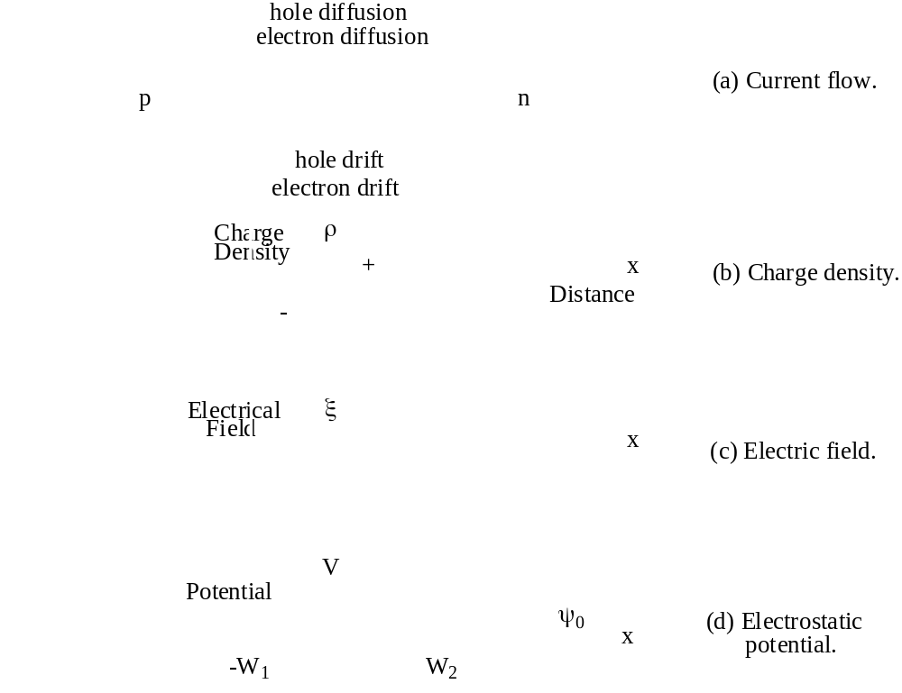
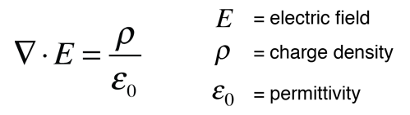

Depletion Region

Slide 6
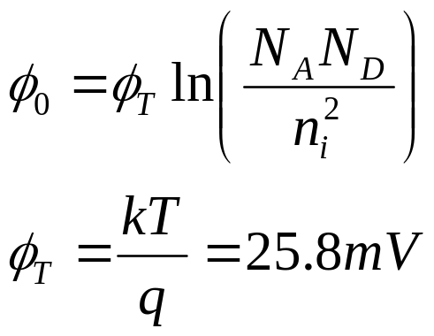

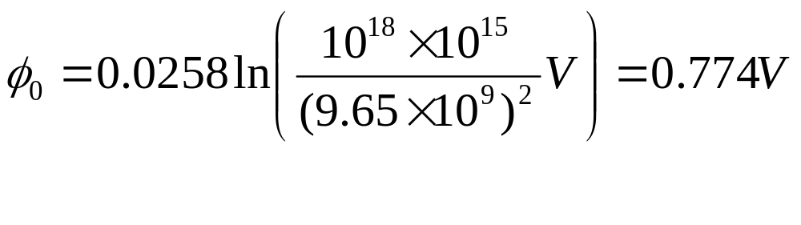
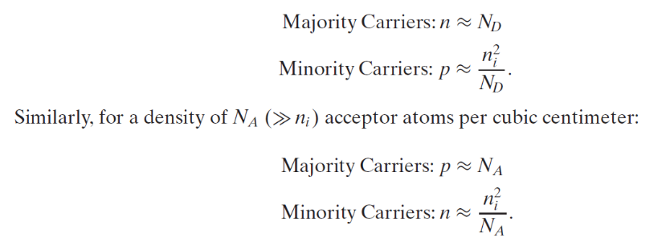
DC Characteristics
k=1.38×10^{–23}J/K
For example, a Si p-n junction,
3: CMOS Transistor Theory
Notes:
Intrinsic

Slide 7
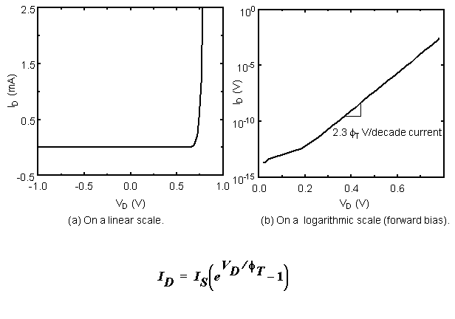
Diode Current

Slide 8
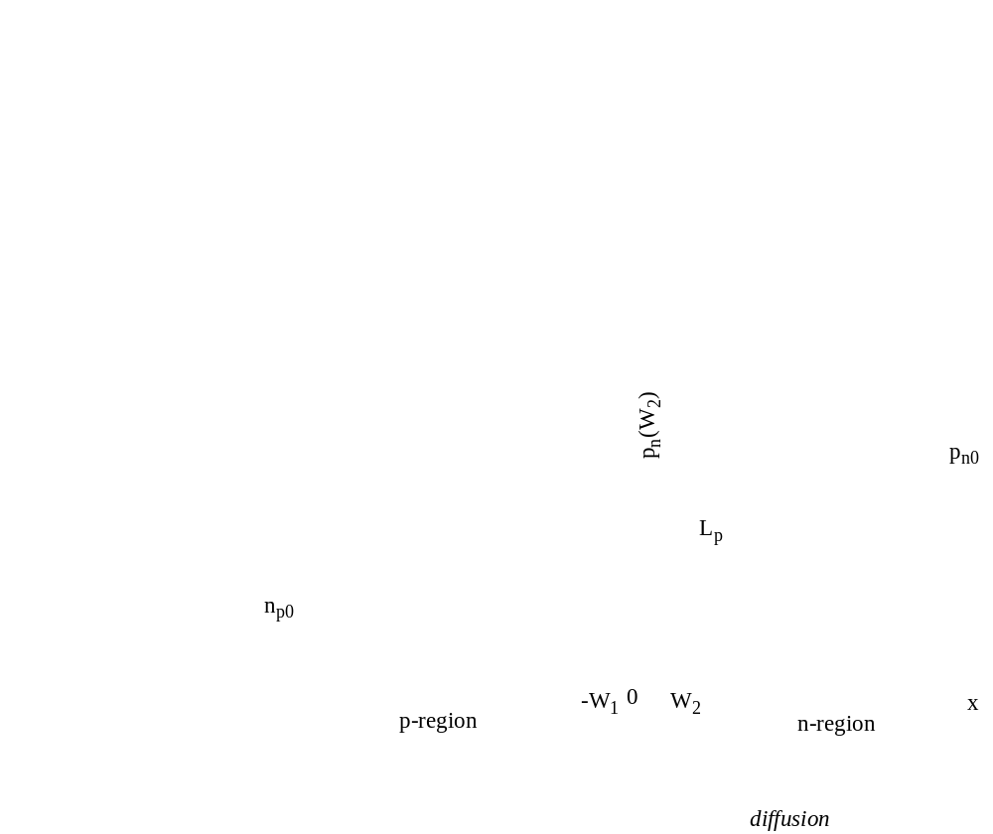
Forward Bias
Typically avoided in Digital ICs

Slide 9
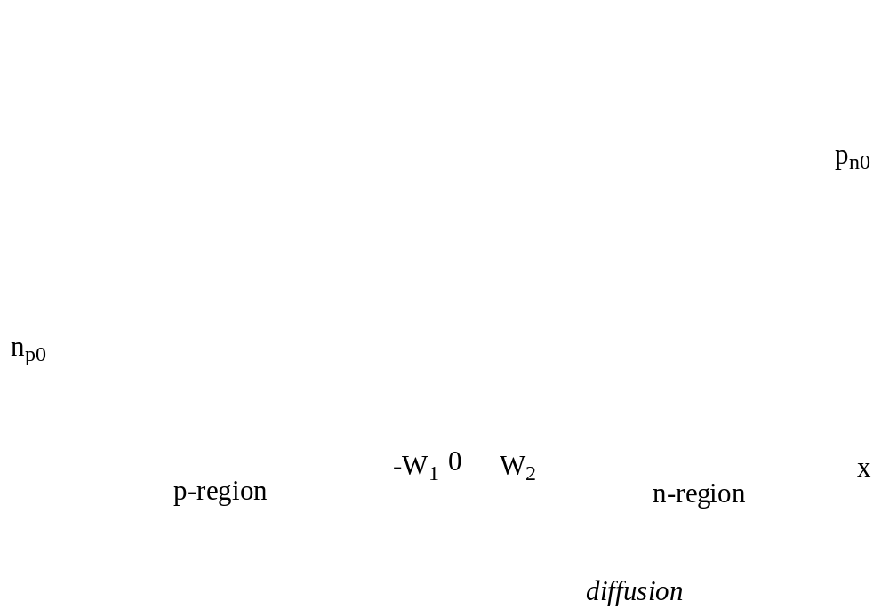
Reverse Bias
The Dominant Operation Mode

Slide 10
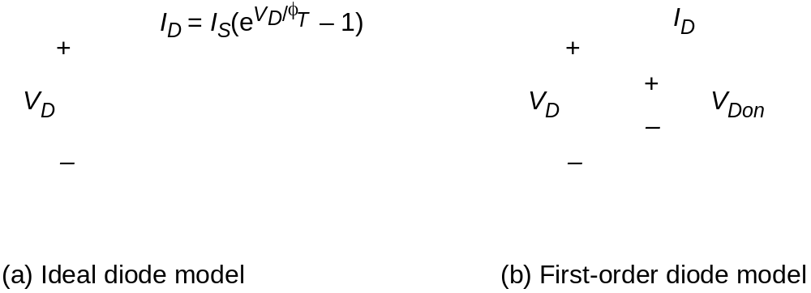
Models for Manual Analysis

Slide 11
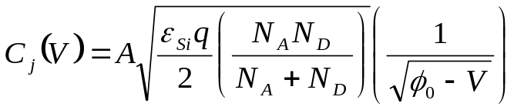
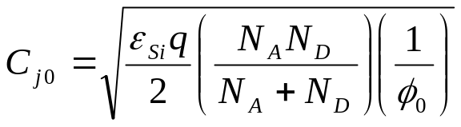
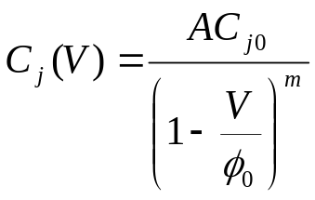
Junction Capacitance
in a more general form as
m is the gradient coefficient and is 0.5 for abrupt junctions and 1/3 for linearly graded junction profiles
The value of the junction capacitance ultimately depends on the external bias voltage applied across the pn-junction.
3: CMOS Transistor Theory

Slide 12
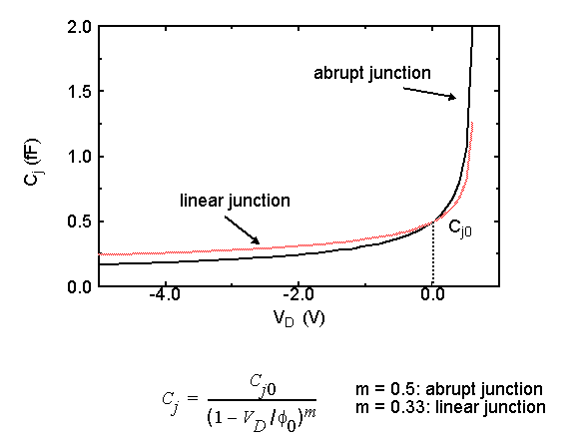
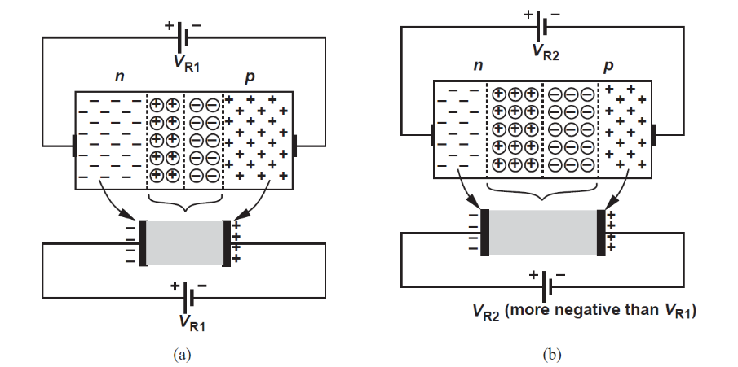
Junction Capacitance

Slide 13
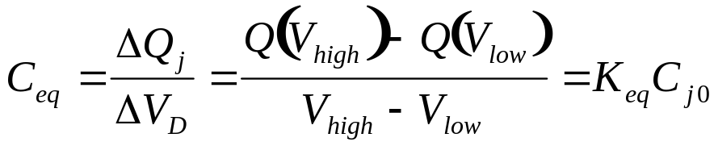
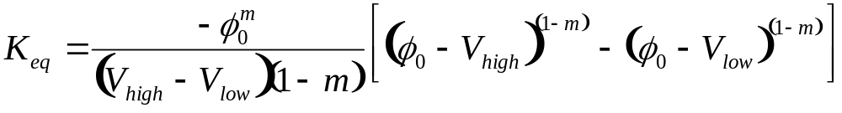
Junction Capacitance
m is known as the grading coefficient.
Keep in mind that C_{j} is a small signal parameter. For large signal switching, an equivalent capacitance has to be calculated as
C_{eq} has been defined such that the same amount of charge is transferred as the nonlinear model
3: CMOS Transistor Theory

Slide 14
Junction Capacitance
As a numerical example, a diode is switched between 0 and -2.5 V. The diode has C_{j0} = 2 X 10⁻³ F/m², A_{D} = 0.5 (μm)², Φ₀ = 0.64 V, m = 0.5.
K_{eq} = 0.622, C_{eq} = 1.24 fF/(μm)².
3: CMOS Transistor Theory

Slide 15
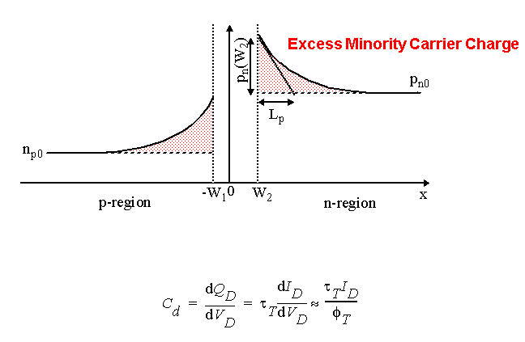

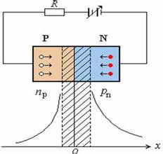
Diffusion Capacitance

Slide 16
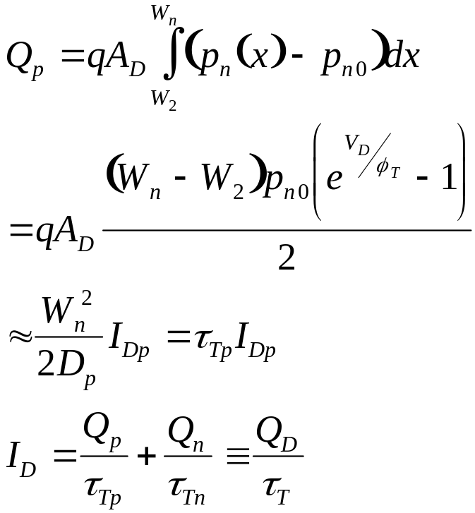
Diffusion Capacitance
Effective in forward bias
3: CMOS Transistor Theory

Slide 17
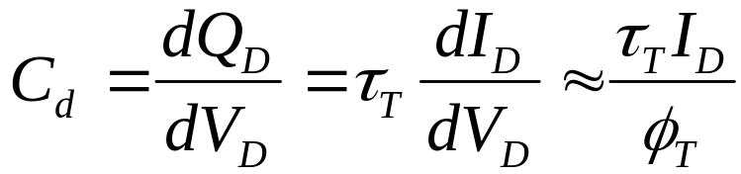
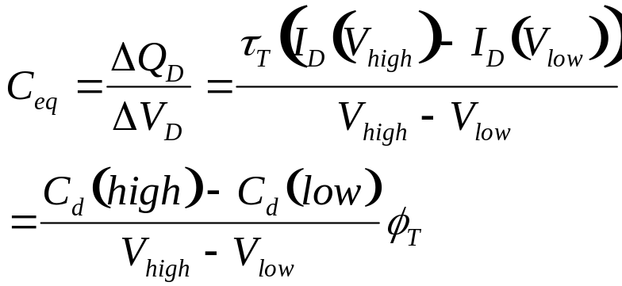
Diffusion Capacitance
From this lifetime analysis of excess charge,
Note that C_{d} is also a small signal capacitance
3: CMOS Transistor Theory

Slide 18
Other Diode Parameters
Secondary Effects
  Resistivity of regions outside junction
  Breakdown voltage
  Temperature dependence
    Φ_{T} has a linear dependence
    I_{S} doubles every 8˚C
    Overall, current doubles every 12˚C.
3: CMOS Transistor Theory

Slide 19
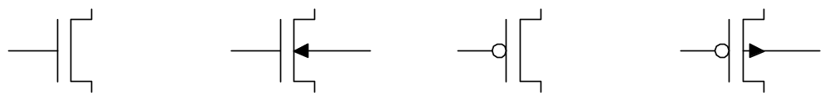
Introduction
So far, we have treated transistors as ideal switches
An ON transistor passes a finite amount of current
  Depends on terminal voltages
  Derive current-voltage (I-V) relationships
Transistor gate, source, drain all have capacitance
  I = C (ΔV/Δt) -> Δt = (C/I) ΔV
  Capacitance and current determine speed
3: CMOS Transistor Theory

Slide 20
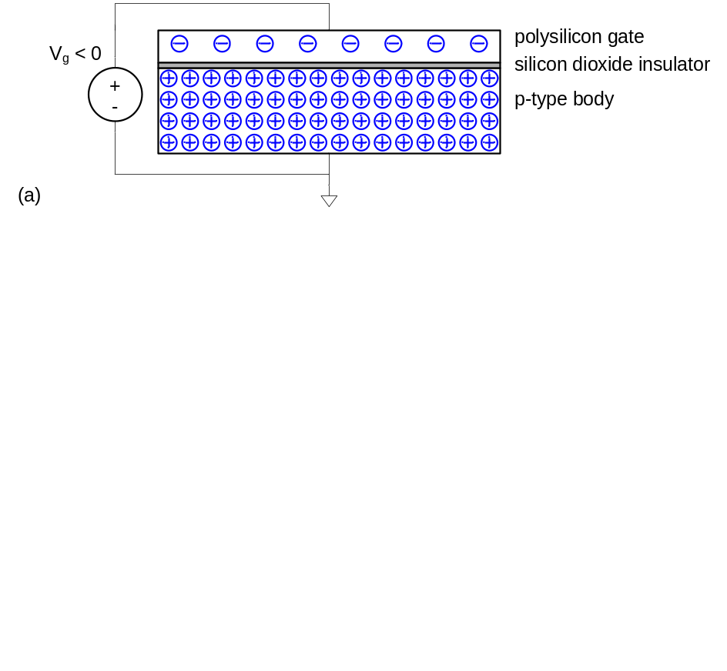
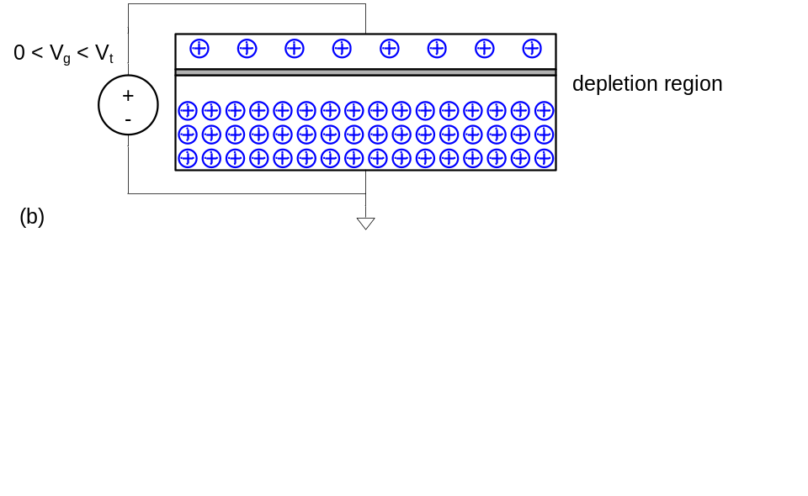
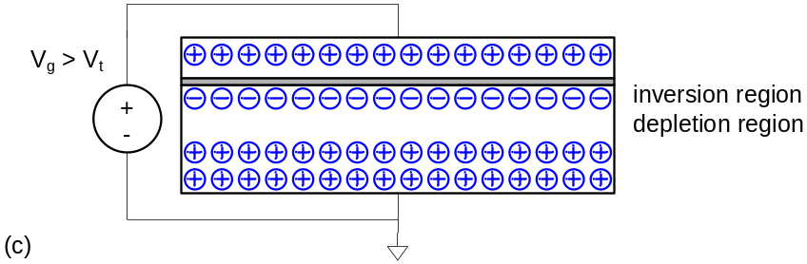
MOS Capacitor
Gate and body form MOS capacitor
Operating modes
  Accumulation
  Depletion
  Inversion
3: CMOS Transistor Theory

Slide 21
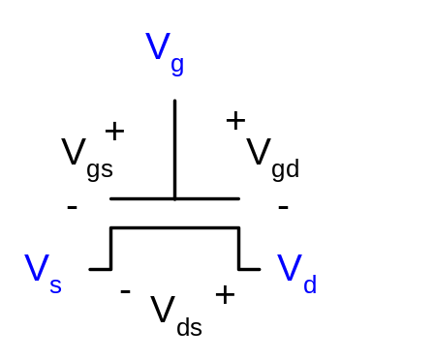
Terminal Voltages
Mode of operation depends on V_{g}, V_{d}, V_{s}
  V_{gs} = V_{g} – V_{s}
  V_{gd} = V_{g} – V_{d}
  V_{ds} = V_{d} – V_{s} = V_{gs} - V_{gd}
Source and drain are symmetric diffusion terminals
  By convention, source is terminal at lower voltage
  Hence V_{ds} ≥ 0
nMOS body is grounded. First assume source voltage is 0 too.
Three regions of operation
  Cutoff
  Linear (Resistive)
  Saturation (Active)
3: CMOS Transistor Theory

Slide 22
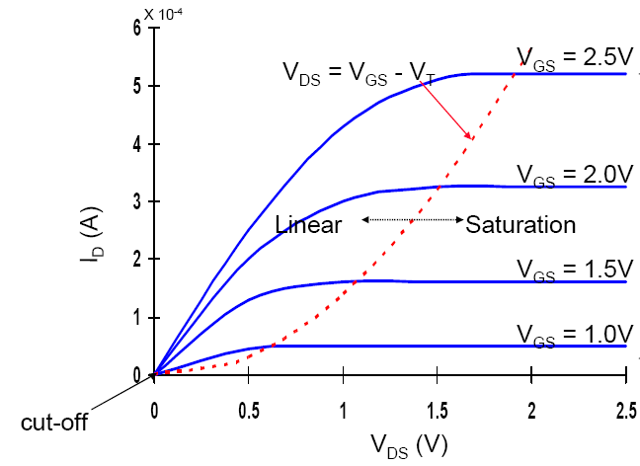
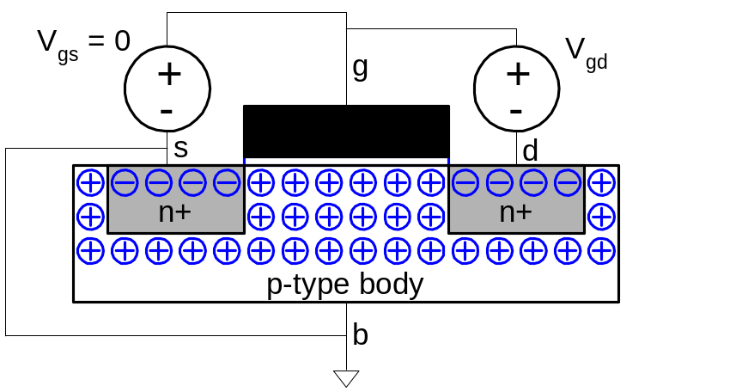
nMOS Cutoff
No channel
I_{ds} ≈ 0
3: CMOS Transistor Theory

Slide 23
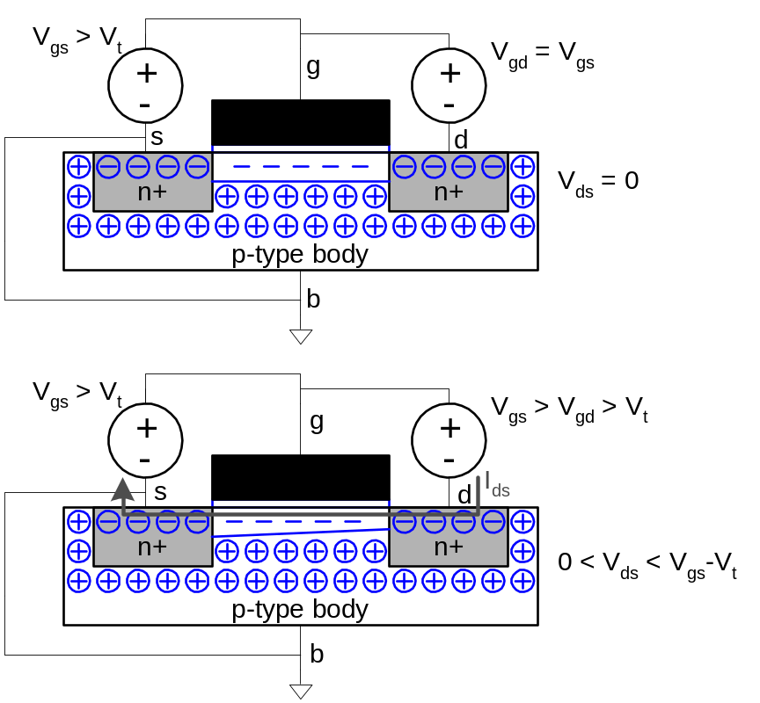
nMOS Linear
Channel forms
Current flows from d to s
  e⁻ from s to d
I_{ds} increases with V_{ds}
Similar to linear resistor
  V_{ds} = V_{d} – V_{s} = V_{gs} - V_{gd}
3: CMOS Transistor Theory

Slide 24
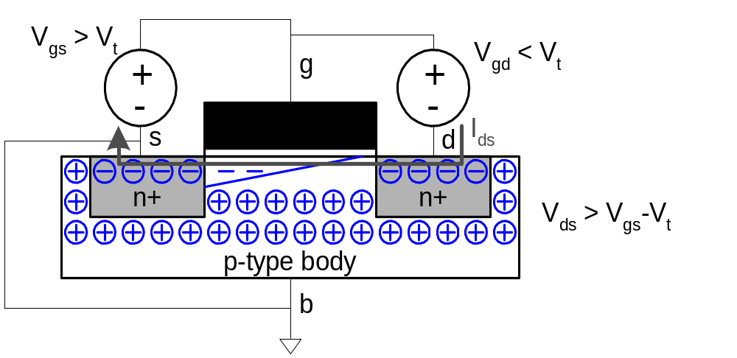
nMOS Saturation
Channel pinches off
I_{ds} independent of V_{ds}
We say current saturates
Similar to current source
  V_{ds} = V_{d} – V_{s} = V_{gs} - V_{gd}
3: CMOS Transistor Theory

Slide 25

Mosfet basic operation
3: CMOS Transistor Theory

Slide 26
I-V Characteristics
In Linear region, I_{ds} depends on
  How much charge is in the channel?
  How fast is the charge moving?
3: CMOS Transistor Theory

Slide 27
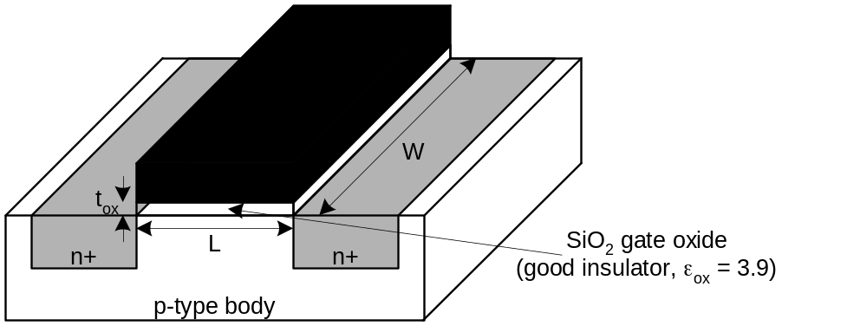
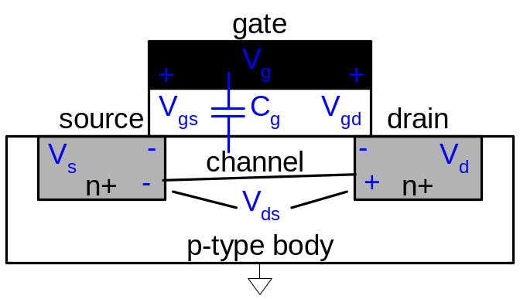
Channel Charge
MOS structure looks like parallel plate capacitor while operating in inversions
  Gate – oxide – channel
Q_{channel} = CV
C = C_{g} = ε_{ox}WL/t_{ox} = C_{ox}WL
V = V_{gc} – V_{t} = (V_{gs} – V_{ds}/2) – V_{t}
V_{c} = (V_{s} + V_{d})/2 = V_{s} + V_{ds}/2
V_{g} – V_{c} = V_{gs} – V_{ds} /2
C_{ox} = ε_{ox} / t_{ox}
3: CMOS Transistor Theory
Notes:
Vc = (Vs + Vd)/2 = Vs + Vds/2; Therefore, the mean difference between the gate and channel potentials Vgc is Vg – Vc = Vgs – Vds /2

Slide 28
Carrier velocity
Charge is carried by e-
Electrons are propelled by the lateral electric field between source and drain
  E = V_{ds}/L
Carrier velocity v proportional to lateral E-field
  v = μE μ called mobility
Time for carrier to cross channel:
  t = L / v
3: CMOS Transistor Theory

Slide 29
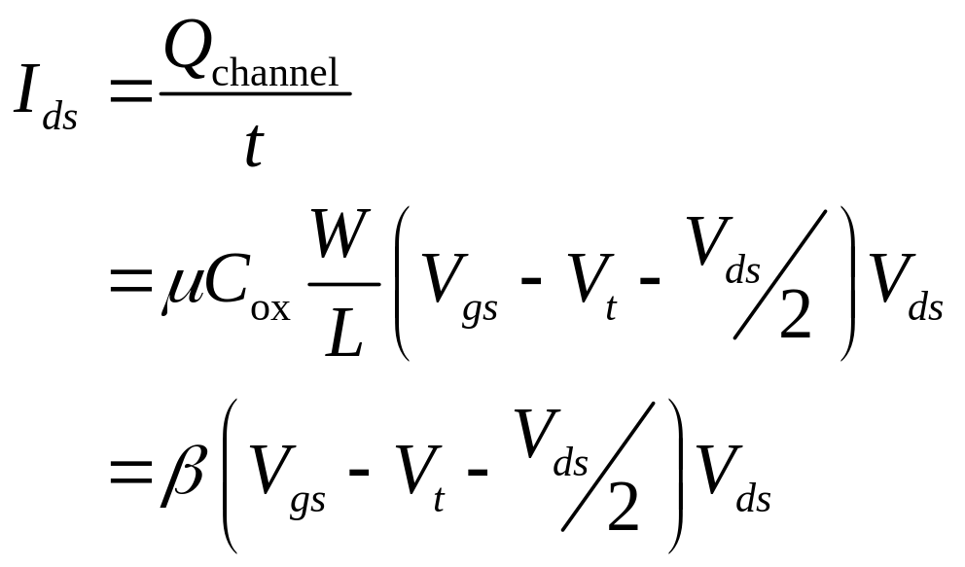
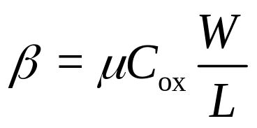
nMOS Linear I-V
Now we know
  How much charge Q_{channel} is in the channel
  How much time t each carrier takes to cross
3: CMOS Transistor Theory

Slide 30
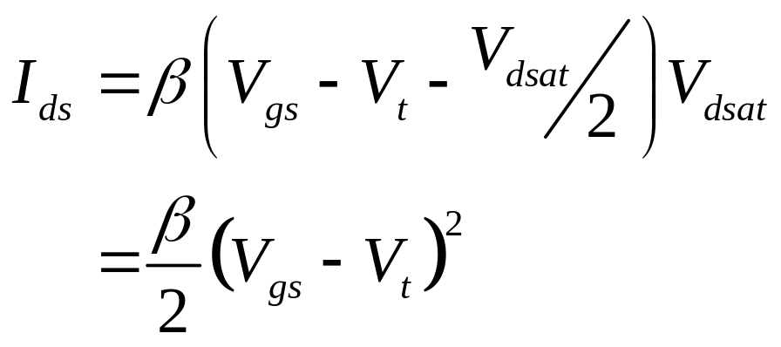
nMOS Saturation I-V
If V_{gd} < V_{t}, channel pinches off near drain
  When V_{ds} > V_{dsat} = V_{gs} – V_{t}
Now drain voltage no longer increases current
3: CMOS Transistor Theory

Slide 31
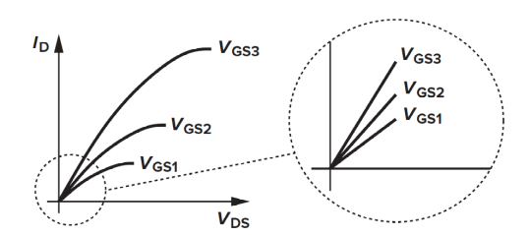
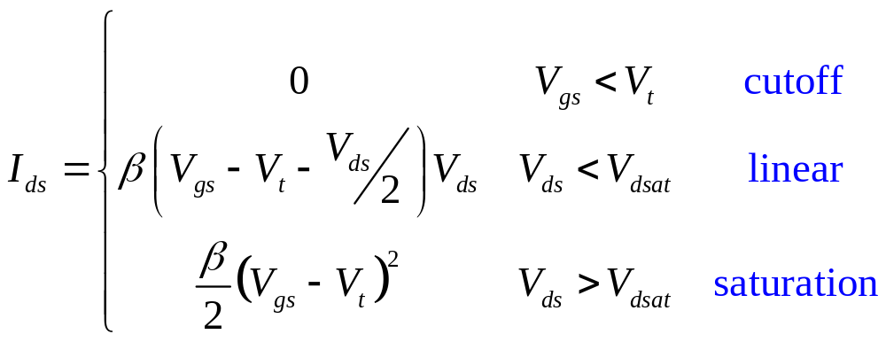
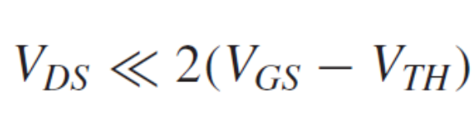
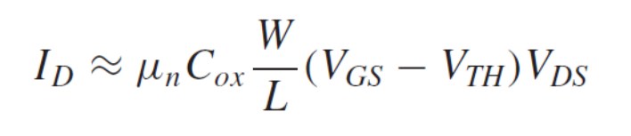
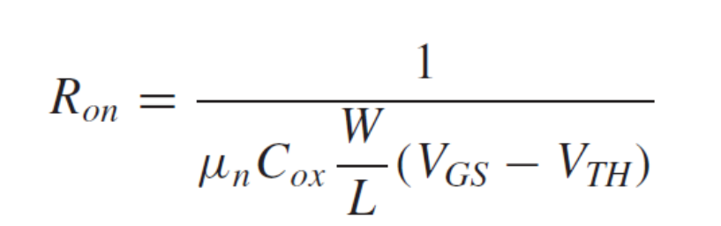
nMOS I-V Summary
Shockley 1st order transistor models
overdrive voltage
3: CMOS Transistor Theory

Slide 32
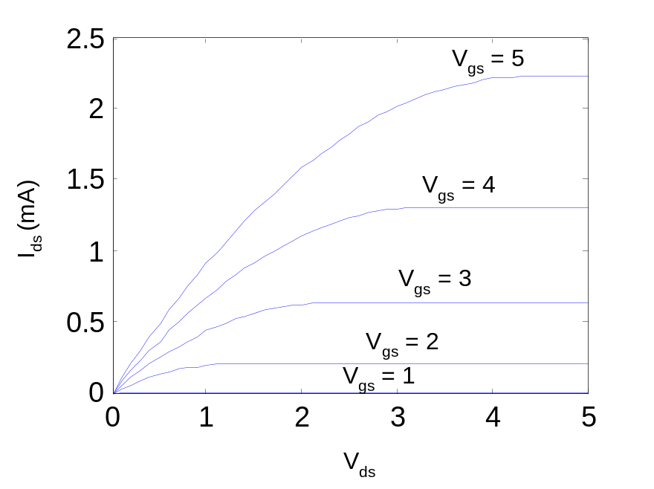
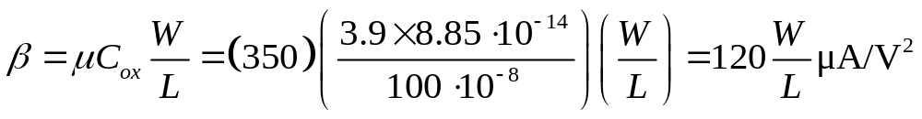
Example
Your book will be using a 0.6 μm process
  From AMI Semiconductor
  t_{ox} = 100 Å
  μ = 350 cm²/V*s
  V_{t} = 0.7 V
Plot I_{ds} vs. V_{ds}
  V_{gs} = 0, 1, 2, 3, 4, 5
  Use W/L = 4/2 λ
3: CMOS Transistor Theory

Slide 33
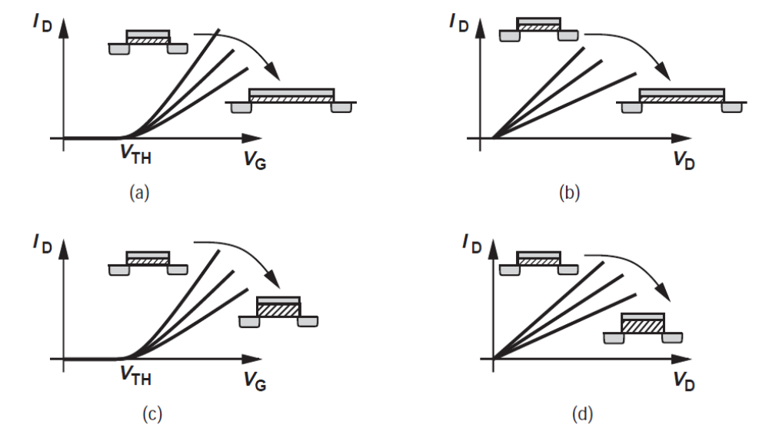
I_{D}-V_{G} and I_{D}-V_{D} characteristics
3: CMOS Transistor Theory

Slide 34
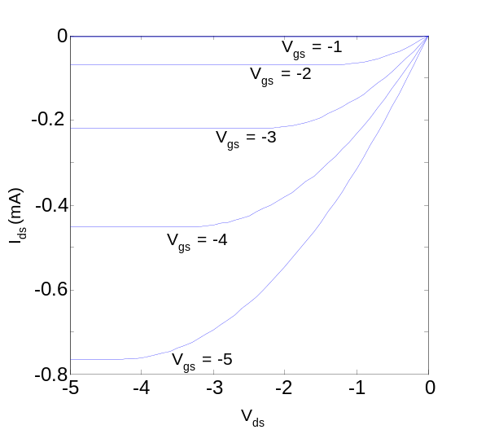
pMOS I-V
All dopings and voltages are inverted for pMOS
  Source is the more positive terminal
Mobility μ_{p} is determined by holes
  Typically 2-3x lower than that of electrons μ_{n}
  120 cm²/V•s in AMI 0.6 μm process
Thus pMOS must be wider to
provide same current
  In this class, assume
  μ_{n} / μ_{p} = 2
3: CMOS Transistor Theory

Slide 35
Capacitance
Any two conductors separated by an insulator have capacitance
Gate to channel capacitor is very important
  Creates channel charge necessary for operation
Source and drain have capacitance to body
  Across reverse-biased diodes
  Called diffusion capacitance because it is associated with source/drain diffusion
3: CMOS Transistor Theory

Slide 36
More Corrections
Mobility is reduced with increasing gate voltage.
  We will study this effect in detail later.
Current conduction occurs below the threshold voltage.
  We will study this effect later.
Channel length modulation has to be corrected.
Threshold voltage depends on W and L.
Parasitic resistances in the source and drain
Latchup
Speed limit of carriers
3: CMOS Transistor Theory

Slide 37
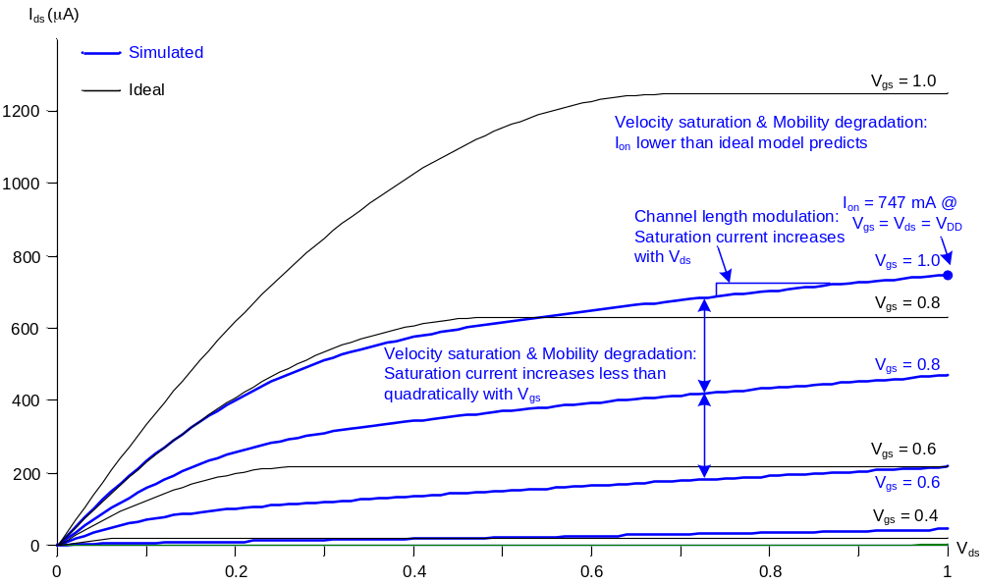
Ideal vs. Simulated nMOS I-V Plot
65 nm IBM process, V_{DD} = 1.0 V
4: Nonideal Transistor Theory

Slide 38
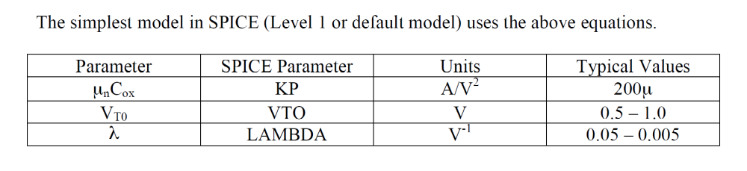
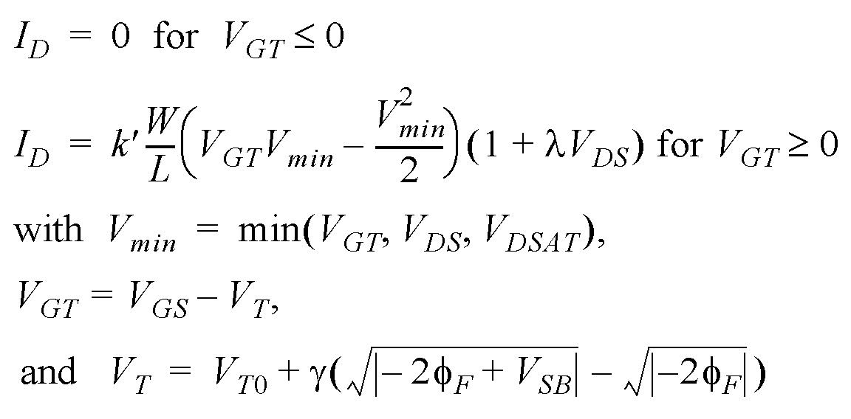
A Unified Model for Manual Analysis

Slide 39
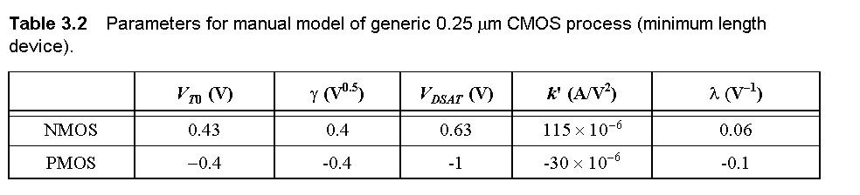
Transistor Model for Manual Analysis

Slide 40
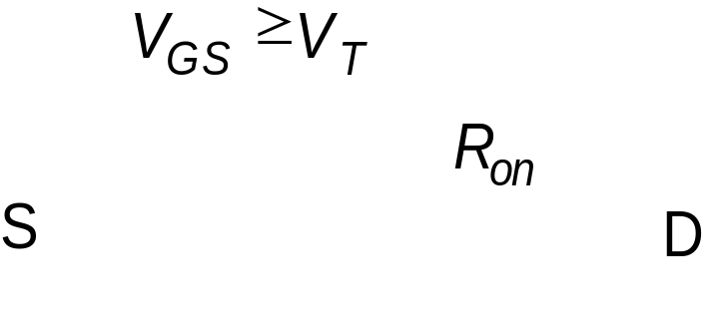
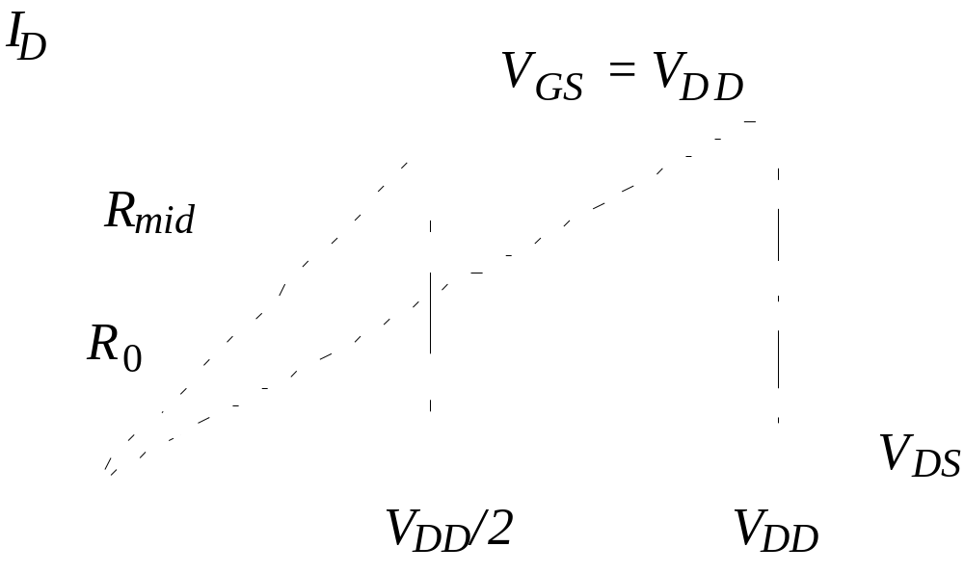

The Transistor as a Switch

Slide 41


Drain-Source Resistance
Applying the general formula for a transistor switching from V_{DD} to V_{DD}/2,
Alternatively, using the endpoints and averaging,
3: CMOS Transistor Theory

Slide 42

Drain-Source Resistance

Slide 43

Drain-Source Resistance

Slide 44


Drain-Source Resistance
Large signal drain-source resistance is a nonlinear quantity varying across operating regions.
One can define an equivalent resistance
For a weakly nonlinear function,
3: CMOS Transistor Theory

Slide 45
Drain-Source Resistance
Note the following
  R is inversely proportional to W/L
  For V_{DD} >> V_{T} + V_{D,sat}/2, R is independent of V_{DD}.
  When V_{DD} is close to V_{T}, resistance increases.
3: CMOS Transistor Theory

Slide 46


MOS Capacitances
3: CMOS Transistor Theory

Slide 47

Gate Capacitance
Approximate channel as connected to source
C_{gs} = ε_{ox}WL/t_{ox} = C_{ox}WL = C_{permicron}W
C_{permicron} is typically about 2 fF/μm
3: CMOS Transistor Theory

Slide 48




Gate Capacitance
Operation Region | C_{gb} | C_{gs} | C_{gd}
Cut-off | C_{ox}WL_{eff} | C_{ov} | C_{ov}
Resistive | 0 | C_{ox}WL_{eff}/2 + C_{ov} | C_{ox}WL_{eff}/2 + C_{ov}
Active | 0 | (2/3) C_{ox}WL_{eff} + C_{ov} | C_{ov}
3: CMOS Transistor Theory

Slide 49



Gate Capacitance
Transistor in Cutoff
Transistor in Linear Region
When the transistor is off, no carriers in channel
to form the other side of the capacitor.
– Substrate acts as the other capacitor terminal
– Capacitance becomes series combination of gate
oxide and depletion capacitance
Channel is formed and acts as the other terminal
–Cgb drops to zero (shielded by channel)
– Model by splitting oxide cap equally between
source and drain
– Changing either voltage changes the channel charge
Transistor in Saturation Region
Changing source voltage doesn’t change VGC
uniformly
– E.g. Vgc at pinch off point still Vth
Cgs =(2/3) C_{ox}WL_{eff}
Drain voltage no longer affects channel charge
– Set by source and Vds_sat
􀂃 If change in charge is 0, Cgd = 0
3: CMOS Transistor Theory

Slide 50


Diffusion Capacitance
C_{sb}, C_{db}
Undesirable, called parasitic capacitance
Capacitance depends on area and perimeter
  Use small diffusion nodes
  Comparable to C_{g}
  for contacted diff
  ½ C_{g} for uncontacted
  Varies with process
3: CMOS Transistor Theory

Slide 51







􀂃 Bottom
–Area cap
–Cbottom = Cj·Ls·W
􀂃 Sidewalls
– Perimeter cap
–Csw = Cjsw·(2LS+W)
􀂃 Gate edge
–Cge = Cjswg·W
– Usually automatically included in the SPICE model
+Cjswg·W
3: CMOS Transistor Theory

Slide 52
Capacitance Model Summary
􀂉 Gate-Channel Capacitance
Cgc ≈0 (|VGS| < |VT|)( off)
Cgc =Cgd Cox·W·Leff (Linear)
– 50% g to s, 50% g to d
Cgc = (2/3)·Cox·W·Leff (Saturation)
– 100% g to s
􀂉 Gate Overlap Capacitance
(Always)
􀂉 Junction/Diffusion Capacitance
Cdiff = Cj·LS·W + Cjsw·(2LS + W) + CjgswgW(Always)
3: CMOS Transistor Theory

Slide 53

Capacitances in 0.25 μm CMOS Process

Slide 54


Sub-Threshold Conduction
10
-2
The Slope Factor
Linear
10
-4
10
-6
Quadratic
(A)
S is ΔV_{GS} for I_{D2}/I_{D1} =10
I
D
10
-8
Exponential
10
-10
V_{T}
10
-12
Typical values for S:
60 .. 100 mV/decade
0
0.5
1
1.5
2
2.5
V
GS
(V)

Slide 55


Sub-Threshold I_{D} vs V_{GS}
V_{DS} from 0 to 0.5V

Slide 56


Sub-Threshold I_{D} vs V_{DS}
V_{GS} from 0 to 0.3V

